Slide 1
ENGI 301 MusicBox Proposal
02/13/2023
Connor Kelly

Slide 2
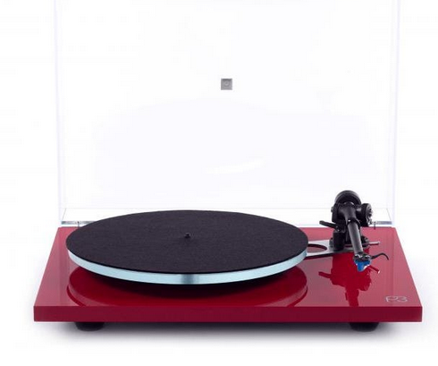
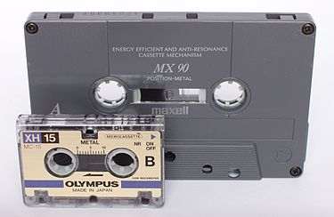
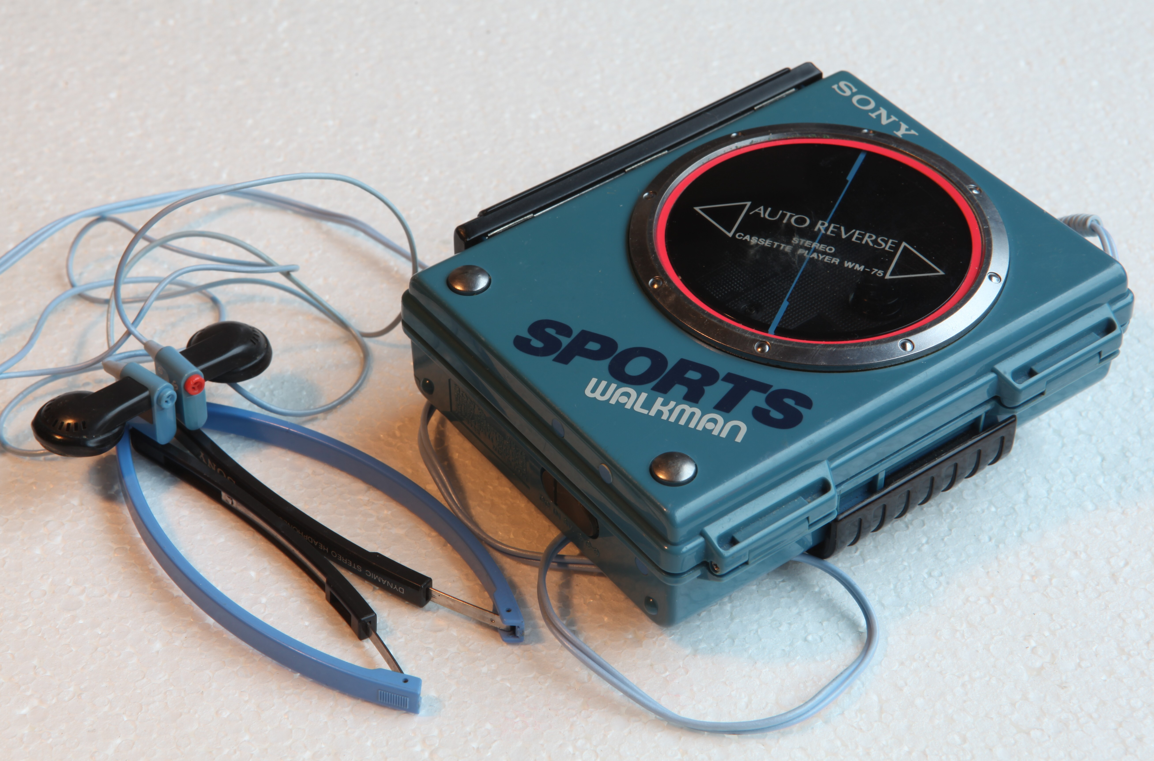
Background Information
When I got a record player and a small vinyl catalog as a present from my grandparents, I initially considered it a novelty, until I realized how much more I enjoyed the music coming from the player.
I found a certain magic in the fact that I can just press play. I’m so used to having my spotify playlist, and being able to pause or skip or queue, all from my phone. With the record player, those simply aren’t options, and I think this may be a contributing factor to my enjoyment.
So, my goal is to create something similar, yet modern: I plan to create simple USB "cartridge" based audio player.
Software: https://mopidy.com
Another Link: https://magpi.raspberrypi.com/articles/build-a-home-music-system-with-raspberry-pi

Slide 3
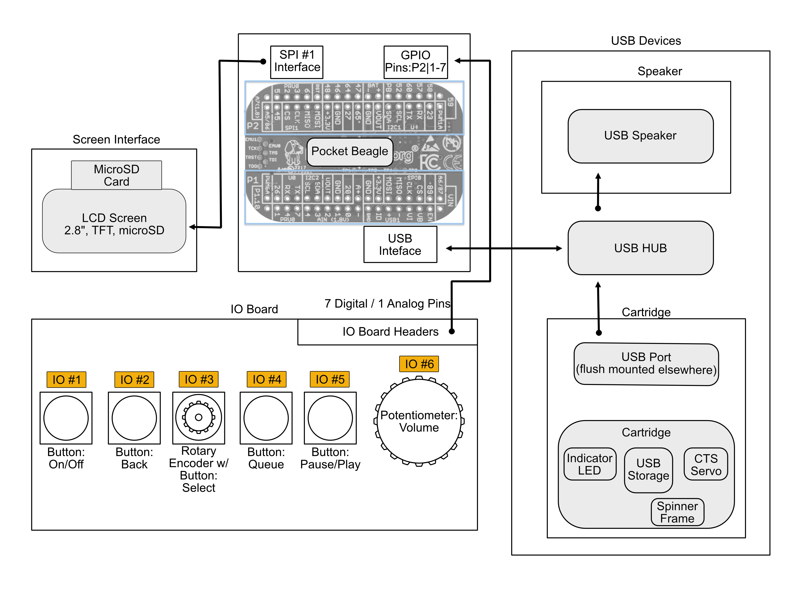
System Block Diagram

Slide 4
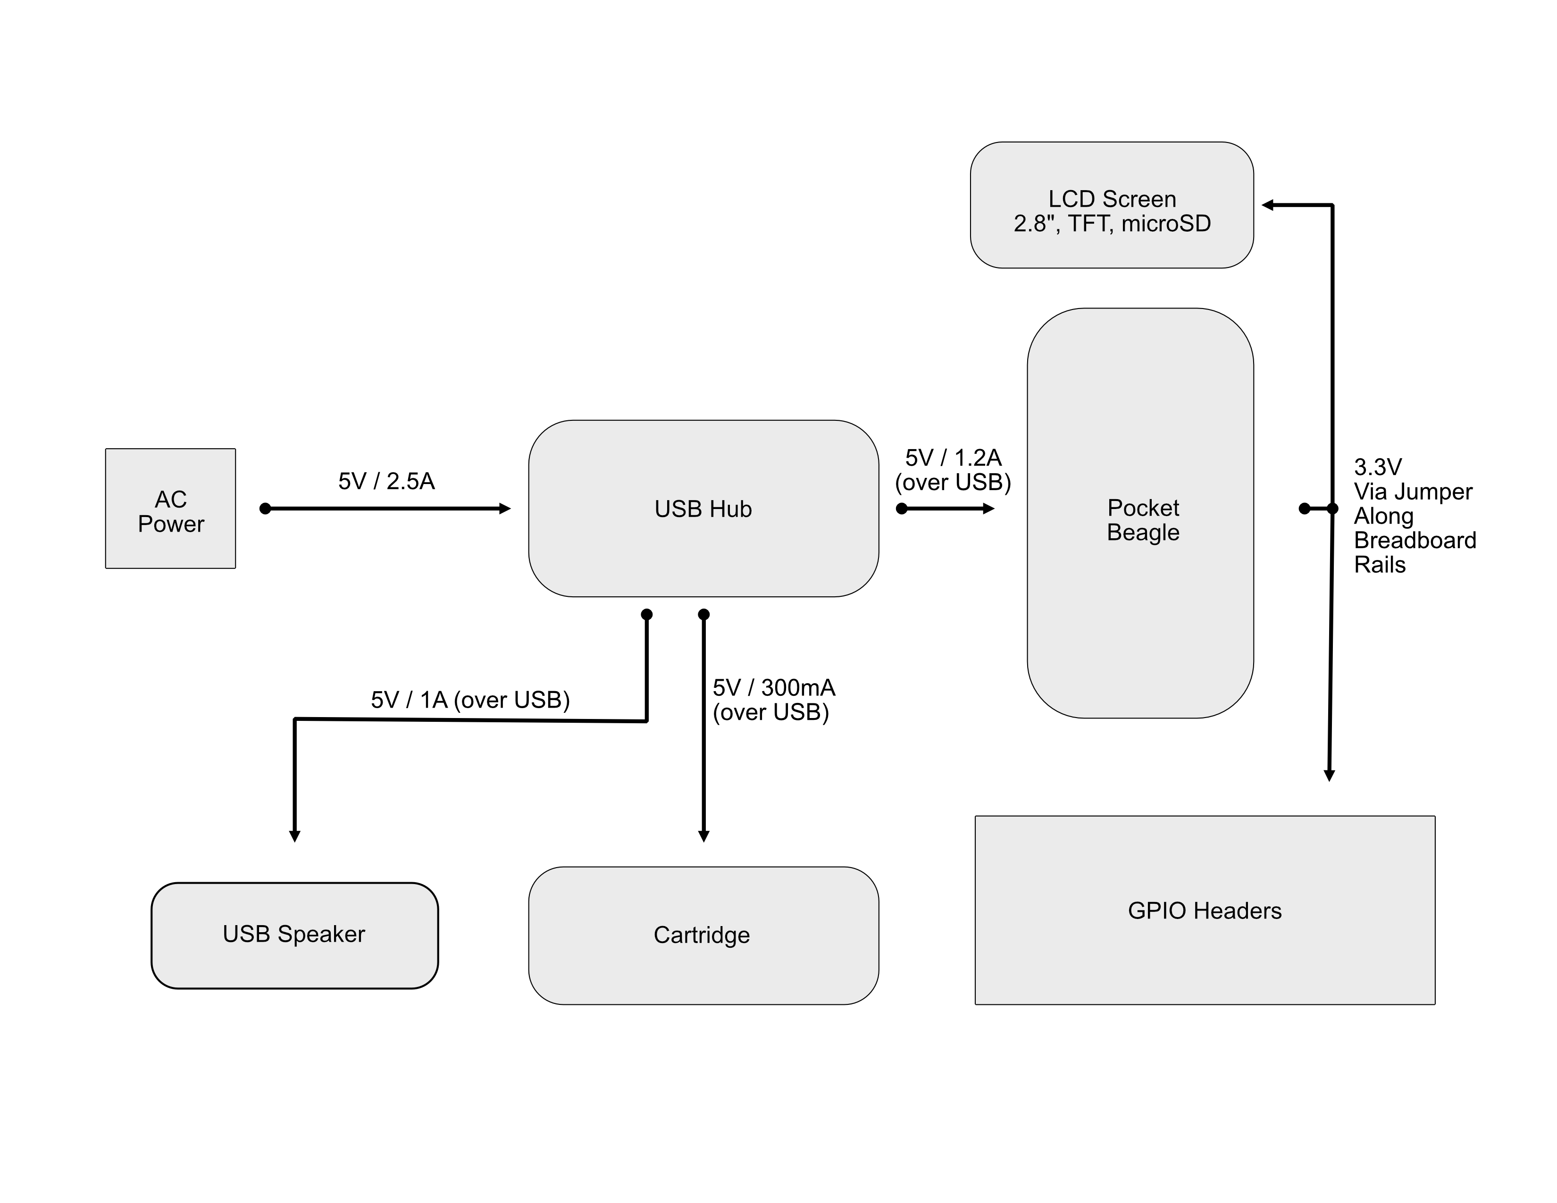
Power Block Diagram

Slide 5
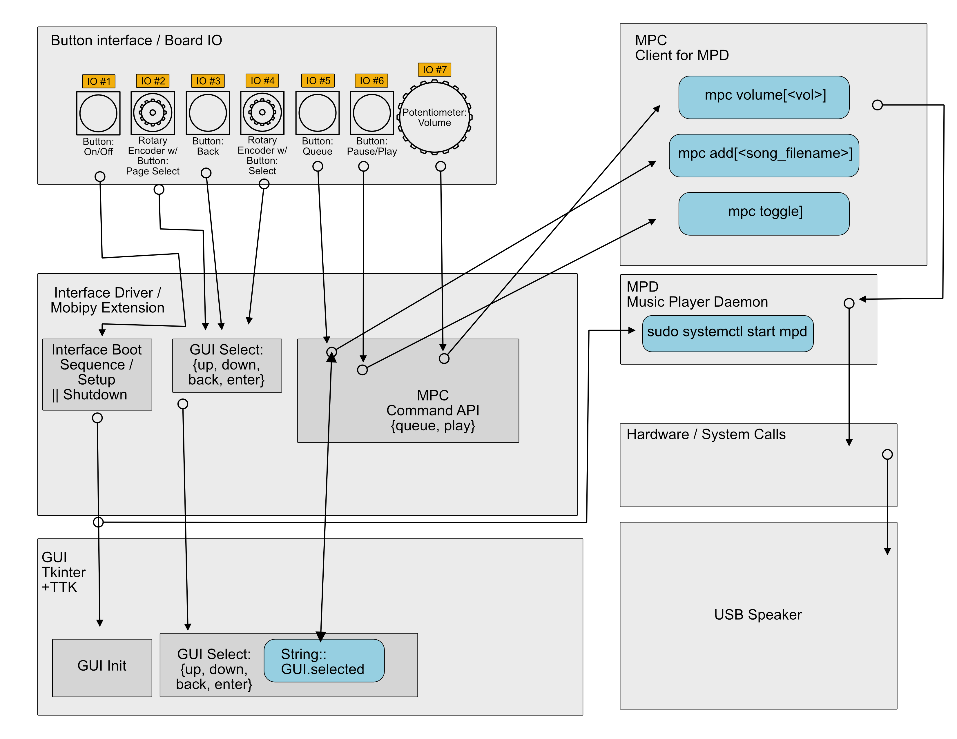
Software Block Diagram

Slide 6
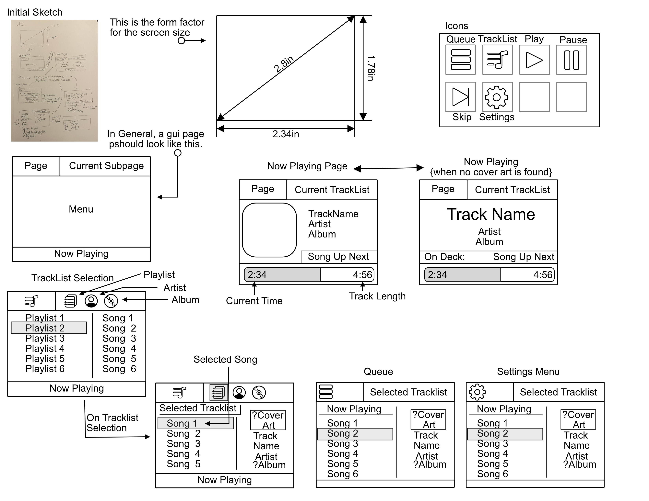
GUI Diagram

Slide 7
Components / Budget
Component | Need to Buy | Cost
BeagleBoard PocketBeagle | No | ($47.50)
USB Hub | https://a.co/d/fYHrCPh | Yes | $19.99
USB Speaker | https://a.co/d/8OIqLUI | Yes | $13.58
LCD Screen 2.8” TFT | https://www.adafruit.com/product/1770 | Yes | $29.95
Buttons x 4 | https://www.adafruit.com/product/367 | No * | [$2.50] ($0.75)
Potentiometer (Flush Mount) | https://www.adafruit.com/product/562 | No * | ($0.95)
USB Flash Drive | https://a.co/d/8lfc9hB | No * | [$24.68] ($2.46)
LED | No | [$4.95] ($0.20)
Continuous Servo | https://a.co/d/6aKJO0a | Yes | [$26.99] $5.40
USB Breakout | https://a.co/d/d0jVBUZ | No | [$6.99] ($0.70)
Rotary Encoder | https://www.adafruit.com/product/377 | No | ($4.50)
Total |  | $71.32
No * : indicates items which don’t need to be bought, but may be included in a final/finished prototype
[price] : indicates the total price of a bulk item
(price) : indicates a quantity price which is excluded because it doesn’t need to be bought

